Slide 1



"Marketline is an extremely useful resource. very relevant to our students· needs and easy to understand. Our students find it invaluable."
Electronic Services Team - The Library- University of East Anglia
"Our delegates find the industry reports on MarketLine invaluable for their project work and course related studies. They appreciate their scope and global coverage as well as the five forces analysis. They find the SWOT analysis chapter of the company profiles particularly useful. The country reports offer delegates a good starting point when looking at international business environments."
Knowledge Interchange Information Executive - Cranfield School of Management
"MarketLine is the go-to place for Canadian information on all types of industries. It is one of the first databases marketing students use as faculty refer to information found in MarketLine reports. I find it is easy to use and use it often."
Library Technician.
"Marketline Advantage is a constant go-to resource for our business students at the Schulich School of Business. They value the market segmentation data and the Five Forces analyses and SWOT analyses especially which are useful for many assignments and projects at both undergraduate and graduate levels. The strength of coverage of Canadian markets is a definite plus. The recent addition of case studies is an added bonus. and the financial deals data is also valuable."
Sophie Bury- York University- Toronto, Ontario
IESE Library has been using MarketLine for a few years now and it is frequently and broadly used by our MBA students. Above all. they love its market data reports and company SWOT analysis because of their user friendly formats and the up-to-date and accurate information they provide."
IESE University, Spain
"Marketline reports provide current. concise, accessible, authoritative analysis via an attractive and user-friendly interface. They are our #1 source for company and industry reports."
Business Librarian - George Fox University
The new Country Analysis feature is very popular with all the marketing academics & they have been getting students to use the data for their assignments. Also, the Market Oata Analytics database within MarketLine is ideal for real marketing intelligence information & comparisons between countries.
Maria Thompson - Queensland University of Technology
"I was searching for a company report for students and Marketline was definitely the best resource and offered the most current data. The report from Marketline was dated less than a month old. The result from an aggregated database was a 2012 report. I will always go directly to Marketline in future."
John Foley- Information Manager - Melbourne Business School
Leading provider in
Market Intelligence & Analytics
Laura Stanham – Account Director
Laura.stanham@marketline.com
www.marketline.com
+44 (0) 207 832 4336

Slide 2


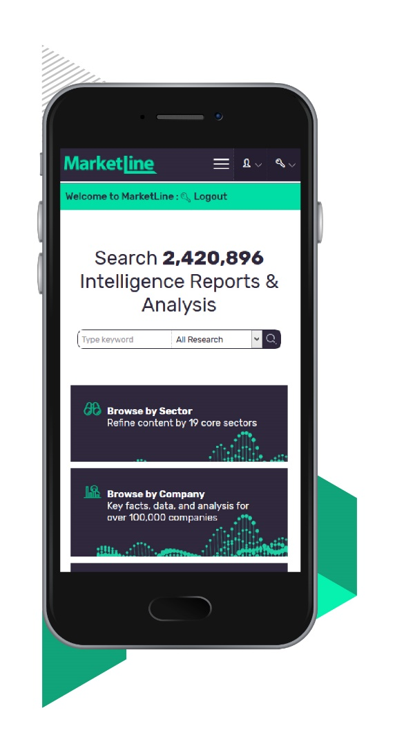
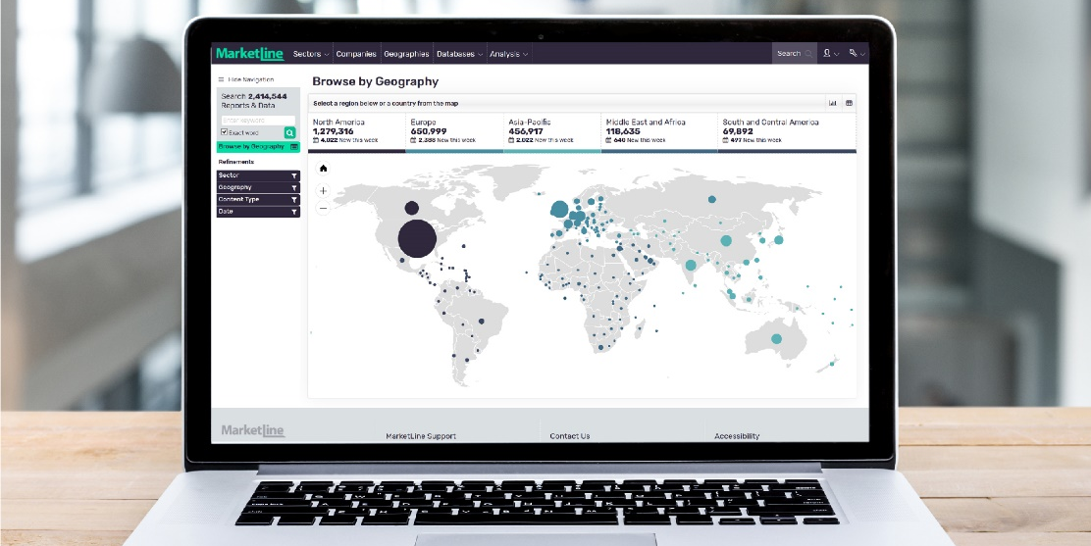








Marketline. a world-leading provider of commercial intelligence. has over 400 experienced analysts. consultants. and researchers with regional and sector expertise in market sizing. competitor tracking. socio and macro economics. and business drivers.
For more than 15 years Marketline Advantage has supported the research needs of investment banks, corporations, professional services firms, and academia with a unique mix of company, industry, country, city and financial data for every major industry and marketplace.
Marketline Service Overview
COMPANIES
INDUSTRIES
• 500,000+ Company Database
• 100,000+ Company Profiles
• 12,000 SWOT Analyses
• 350+ Company Case Studies provide an
in-depth analysis of successful and
unsuccessful company strategies
• Company News and Financial Deals
tracked and updated daily
6500+ Industry Profiles including Porter's Five Forces Analysis
Market values, volumes, and forecasts for over 120 industry sectors and 50 Countries
Theme Reports look into topics or megatrends set to have far reaching impact on the world around us
250+ Industry Case Studies provide in-depth analysis of trends and issues affecting global markets
Industry Value Chain reports reveal and analyse all segments of the value chain, leading players, and burning issues
Marketline Advantage
Comprehensive Coverage
Truly global coverage of all major companies, industries, countries and cities.
Develop knowledge by providing a best-in-class resource
Marketline is relied upon by global blue chip companies. Give your students and staff access to the same data, research and analysis from a best in class provider.
Use Anywhere
Available on or off campus on laptop, tablet or mobile, and compatible with federated identity and search solutions.
Support student and staff research needs with an easy to use on line service
A simple interface, language, extraction capabilities, and free training results in high usage and user satisfaction.
Ask an Analyst
Users can send content queries directly to Marketline Analysts reducing questions for Librarians.
Multi-Disciplinary
Make the most of your academic budget with one cross-curricular business resource that meets the needs of multiple disciplines and departments.
DATA & TOOLS
COUNTRIES & CITIES
Screen companies and build lists of potential business partners, clients, and investment targets from our database of over 500,000 companies
Chartbooks provide quick to understand visual analysis on a variety of sectors, topics and indicators
Influencer Tools identify and track crucial insights from leading digital influencers on the key issues relating to key sectors, issues or themes
Key socio and macroeconomic indicators for more than 200 countries and 1950 Cities
Country Profiles and City Profiles evaluating Political, Economic, Social,
Technological, Legal, and Environmental Factors

